Slide 1
Spiritual Warfare
The Cross and the Sword
An attitude of learning in Jesus

Slide 2
Preparing for this Course
Watch at least 50 minute of this video
You’ll learn how to exercise your authority over the home and by extension over your business, if you are the head, and over the nations of the world.
https://youtu.be/CclHssBTq8c You’ll learn about the government of God and how his Church is expected to take authority in every area, heaven on earth.
If you watch to the end, you’ll hear a powerful prayer of authority

Slide 3
Our Agenda for the Next Few Weeks
Dutch Sheets
“Our Need for Revelation”
15 Minutes
The icon – Jesus said I have many things to tell you but you cannot bear them
The Blue Puzzle piece is added revelation to your incomplete knowledge of God
Notes:
Pastor Jones prayed for Jack to marry Linda. Nicky Cruz.
3 sessions of 2 hours each

Slide 4
Four Major Units
Show up – Learn about Spiritual Warfare
Wise up – Your Power, Your authority
Man up – Study the Rules of Engagement
Suit up – Your Military Equipment

Slide 5
Rules of War
Sun Tsu
Know the Terrain
Know the Enemy
Know Your Authority
Know Your Equipment
Know Your Orders
Know Your Limitations
https://youtu.be/lXXZJfmFTAE?t=120

Slide 6
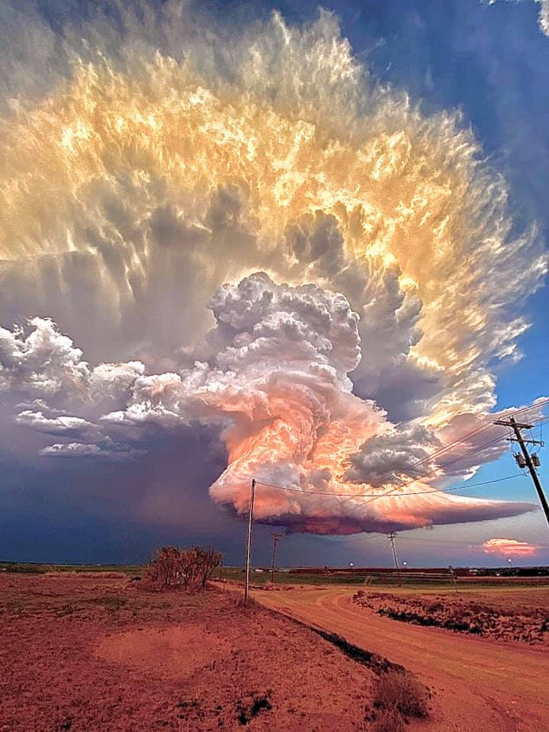
Two Battlegrounds
2nd Heaven
Luke 10:18
And he said unto them, I beheld Satan as lightning fall from heaven.
Ephesians 6:12
For we wrestle not against flesh and blood, but against principalities, against powers, against the rulers of the darkness of this world, against spiritual wickedness in high places.

Slide 7
Who is Your Enemy
Demons, Rulers, Powers
Principalities
  Jezebel always with Ahab
  Baal
  Molech
False Doctrines
  The flesh – We do not allow speaking in tongues here
  The Bible is perfect; The Bible tells us there are things we have yet to learn
  Who is Not your Enemy: The Flesh, because you cannot war against it; you can only crucify it
  Demons are personal; spiritual warfare us impersonal
Notes:
You bring your own needs into them battlefield and God often solves or aids your issues because of your faithfulness

Slide 8
How The Enemy Gains & Maintains Control
Rule by Fear Job 3:25 For the thing I feared has overtaken me, and what I dreaded has happened to me.
John 10:10 A thief comes only to steal and kill and destroy. I have come so that they may have life and have it in abundance.
1 John 5:19 We know that we are of God, and the whole world is under the sway of the evil one.
BUT 1 Corinthians 10:26 since the earth is the Lord’s, and all that is in it.

Slide 9
Prayer, Intercession & Spiritual Warfare
Prayer: Your personal needs and praise or God with requests and thanks for all his benefits
Intercession – Your prayers for people who are either unable or unwilling to pray for themselves in difficult situation. prayers for those you cannot reach by phone, mail or any other way
Spiritual Warfare – Your prayers to declaw major evils in control of large groups, geographical areas, corporations, even nations.

Slide 10
Unconditional Love
Love yes, acceptance no
Conditions: There is no condemnation…….for those NOT living in the flesh and under the Law
The Life-Giving Spirit 8 Therefore, there is now no condemnation for those in Christ Jesus,^{[a]} ² because the law^{[b]} of the Spirit of life in Christ Jesus has set you^{[c]} free from the law^{[d]} of sin and death. ³ For what the law could not do since it was weakened by the flesh, God did. He condemned sin in the flesh by sending his own Son in the likeness of sinful flesh as a sin offering,^{[e]} ⁴ in order that the law’s requirement would be fulfilled in us who do not walk according to the flesh but according to the Spirit. ⁵ For those who live according to the flesh have their minds set on the things of the flesh, but those who live according to the Spirit have their minds set on the things of the Spirit. ⁶ Now the mindset of the flesh is death, but the mindset of the Spirit is life and peace. ⁷ The mindset of the flesh is hostile to God because it does not submit to God’s law. Indeed, it is unable to do so. ⁸ Those who are in the flesh cannot please God. ⁹ You, however, are not in the flesh, but in the Spirit, if indeed the Spirit of God lives in you. If anyone does not have the Spirit of Christ, he does not belong to him. ¹⁰ Now if Christ is in you, the body is dead because of sin, but the Spirit^{[f]} gives life^{[g]} because of righteousness. ¹¹ And if the Spirit of him who raised Jesus from the dead lives in you, then he who raised Christ from the dead will also bring your mortal bodies to life through^{[h]} his Spirit who lives in you.

Slide 11
Garments
Dealing with condemnation
Psalm 19:12 Who can understand his errors? cleanse thou me from secret faults.
Forgiveness of others
Known sin
Pray for the spirit of truth, and cast out the spirit of error
1 John 4:6 We are of God: he that knoweth God heareth us; he that is not of God heareth not us. Hereby know we the spirit of truth, and the spirit of error.

Slide 12
Who Gives the Orders
The Authority you are under
The Equipment
Your Prayers

Slide 13
Power v. Authority
Dunamis v. Exousia
  Blood covers sins but gives the believer the authority to war in His Name.
  Blood redeems so no blood covers demons
  Your Authority Luke 10:19 Behold, I give unto you authority to tread on serpents and scorpions, and over all the power of the enemy: and nothing shall by any means hurt you.
    You have authority, when you use it
    Devil has power – he is defected already as the Bible says

Slide 14

Know Your Equipment
8 Pieces -Suit Up
Mark 11:25 And when ye stand praying, forgive, if ye have ought against any: that your Father also which is in heaven may forgive you your trespasses.
Peter stood, chains fall off; angels had to wake him
¹³ Wherefore take unto you the whole armor of God, that ye may be able to withstand in the evil day, and having done all, to stand.
Nehemiah 8:5- Stand to hear God’s word read, to face them judge, to give orders and to take orders
Forgiveness

Slide 15
Belt, Breastplate, Sandals
Truth is both the Word of God and the presence of Jesus, as Truth incarnate
The breast plate – your heart must be right about the situation
You come in peace , not peace with the enemy which is compromise, but peace with God. God must be glorified.
¹⁴ Stand therefore, having your loins girt about with truth,
and having on the breastplate of righteousness;
¹⁵ And your feet shod with the preparation of the gospel of peace;

Slide 16
²³ So he summoned them and spoke to them in parables: “How can Satan drive out Satan? ²⁴ If a kingdom is divided against itself, that kingdom cannot stand. ²⁵ If a house is divided against itself, that house cannot stand. ²⁶ And if Satan opposes himself and is divided, he cannot stand but is finished. ²⁷ But no one can enter a strong man’s house and plunder his possessions unless he first ties up the strong man. Then he can plunder his house.

Slide 17
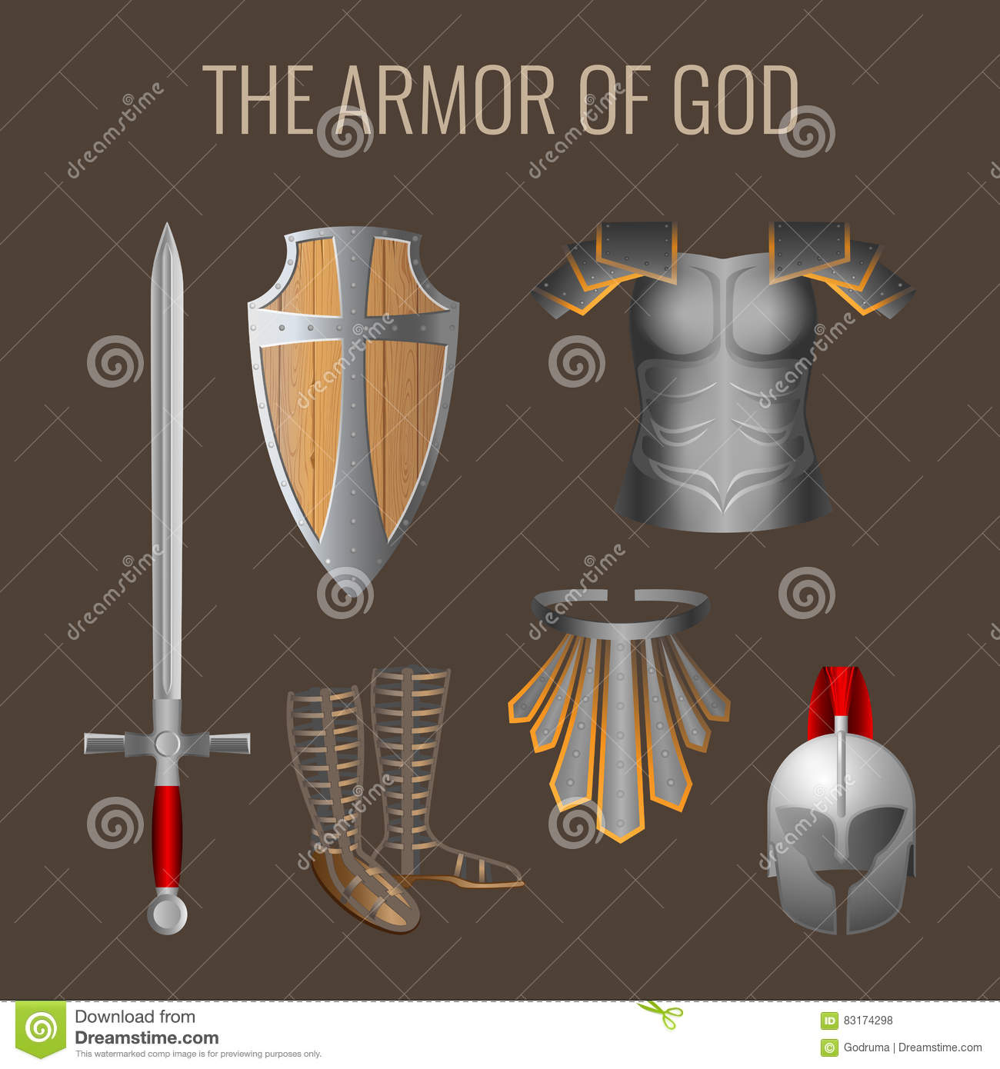
Faith, Helmet, Sword, Spirit
¹⁷ And take the helmet of salvation, and the sword of the Spirit, which is the word of God:
Above all, taking the shield of faith, wherewith ye shall be able to quench fiery darts of the wicked one

Slide 18
Baptism in the Holy Spirit
The final piece of equipment 18 Praying always with all prayer and supplication in the Spirit, and watching thereunto with all perseverance and supplication for all saints;
  Discernment
  Wisdom
  Knowledge
  Understanding
  Tongues are the languages that the enemy cannot understand

Slide 19
Perseverance, Fasting
Daniel 10:3, I didn’t eat any rich food, no meat or wine entered my mouth, and I didn’t put any oil on my body until the three weeks were over.
He ate “seeds” – lima beans, peanuts, and other vegetables
¹²⁻¹⁴“Don’t be afraid, Daniel,” he said to me, “for from the first day that you purposed to understand and to humble yourself before your God, your prayers were heard. I have come because of your prayers. ¹³ But the prince of the kingdom of Persia opposed me for twenty-one days. Then Michael, one of the chief princes, came to help me after I had been left there with the kings of Persia. ¹⁴ Now I have come to help you understand what will happen to your people in the last days, for the vision refers to those days.”

Slide 20
The Authority of the Believer
Luke 4:6 And the devil said unto him, All this power will I give thee, and the glory of them: for that is delivered unto me; and to whomsoever I will I give it.
Matthew 10:1 And when he had called unto him his twelve disciples, he gave them power against unclean spirits, to cast them out, and to heal all manner of sickness and all manner of disease.
Satan’s kingdom is under the law. You are not. He is a defeated foe, you are a victor. He is condemned by the blood, you are empowered by it. He has no choice but to submit to the command of Jesus, you have no reason to not use it.
You are under a Blood covenant, sealed by Jesus’ blood giving your this authority to wield his will on earth

Slide 21
Attacks on Your Person, or Your Property
Agree with your adversary
Reverse the curse spoken over you
God will step in: Psalm 105:15 Touch not mine anointed, and do my prophets no harm.
  2 Chronicles 20:20 Believe in the Lord your God, so shall ye be established; believe his prophets, so shall ye prosper.
Hide us from evil intent, those with bad motives. Those who harm you will suffer in some way

Slide 22
Guard Your Heart
Early will I seek thee
Levels of challenge
Attacks on faith
Precept by precept
Timing
Expose sin - works both ways
Being misunderstood
Hardened Heart -refusal to end known sin,
  cf Pharoah
Attacks on family

Slide 23
Spiritual Cleanup
Porn – clean brain – blood bath, erasure
  Clean out the videos in your brain
Fasting will expose internal demons
False teachings and assumptions, e.g. Old Testament no longer a concern to us
Error of making it a work of the flesh - Galatians 3:28 There is neither Jew nor Greek, there is neither bond nor free, there is neither male nor female: for ye are all one in Christ Jesus.

Slide 24
Paul’s Prayer for His Team
Ephesians ^{16 I} Cease not to give thanks for you, making mention of you in my prayers;
¹⁷ That the God of our Lord Jesus Christ, the Father of glory, may give unto you the spirit of wisdom and revelation in the knowledge of him:
¹⁸ The eyes of your understanding being enlightened; that ye may know what is the hope of his calling, and what the riches of the glory of his inheritance in the saints,
¹⁹ And what is the exceeding greatness of his power to us-ward who believe, according to the working of his mighty power,
²⁰ Which he wrought in Christ, when he raised him from the dead, and set him at his own right hand in the heavenly places,
²¹ Far above all principality, and power, and might, and dominion, and every name that is named, not only in this world, but also in that which is to come:
²² And hath put all things under his feet, and gave him to be the head over all things to the church,

Slide 25
Religious Spirit
The word is not bound 2 Timothy 2:9 Wherein I suffer trouble, as an evil doer, even unto bonds; but the word of God is not bound.
Hate is motivator
What they can’t control
Judgmental
Hard heart
Spirit of murder
Stubbornness is as witchcraft

Slide 26
Fear of the Lord
Hate evil
Beginning of wisdom
Required
Attitude
Kingdom – no Greek ,bond free etc
Reminds you that you don’t know everything and if you know it, possibly so does the enemy – your ignorance protects you so you can take direction from Holy Spirit

Slide 27
How to Pray the Word Back to God
Session 2
Praying the Word with Dutch Sheets
Calling on help from angels

Slide 28
Finding Your Call
The Call and The Watch
  What God has called you to, jurisdiction
    Individuals under attack
    National jurisdictions
    People groups
    Internal problems
      E.g. buying land for church building
  What Prophets have identified as war zones
    No one rises above the level of his information

Slide 29
We live in 3 worlds
Body 1st t get our attention
Soul 2nd to be considered
Spirit Last, if ever
Spirit rules the
Soul rules the
Body

Slide 30
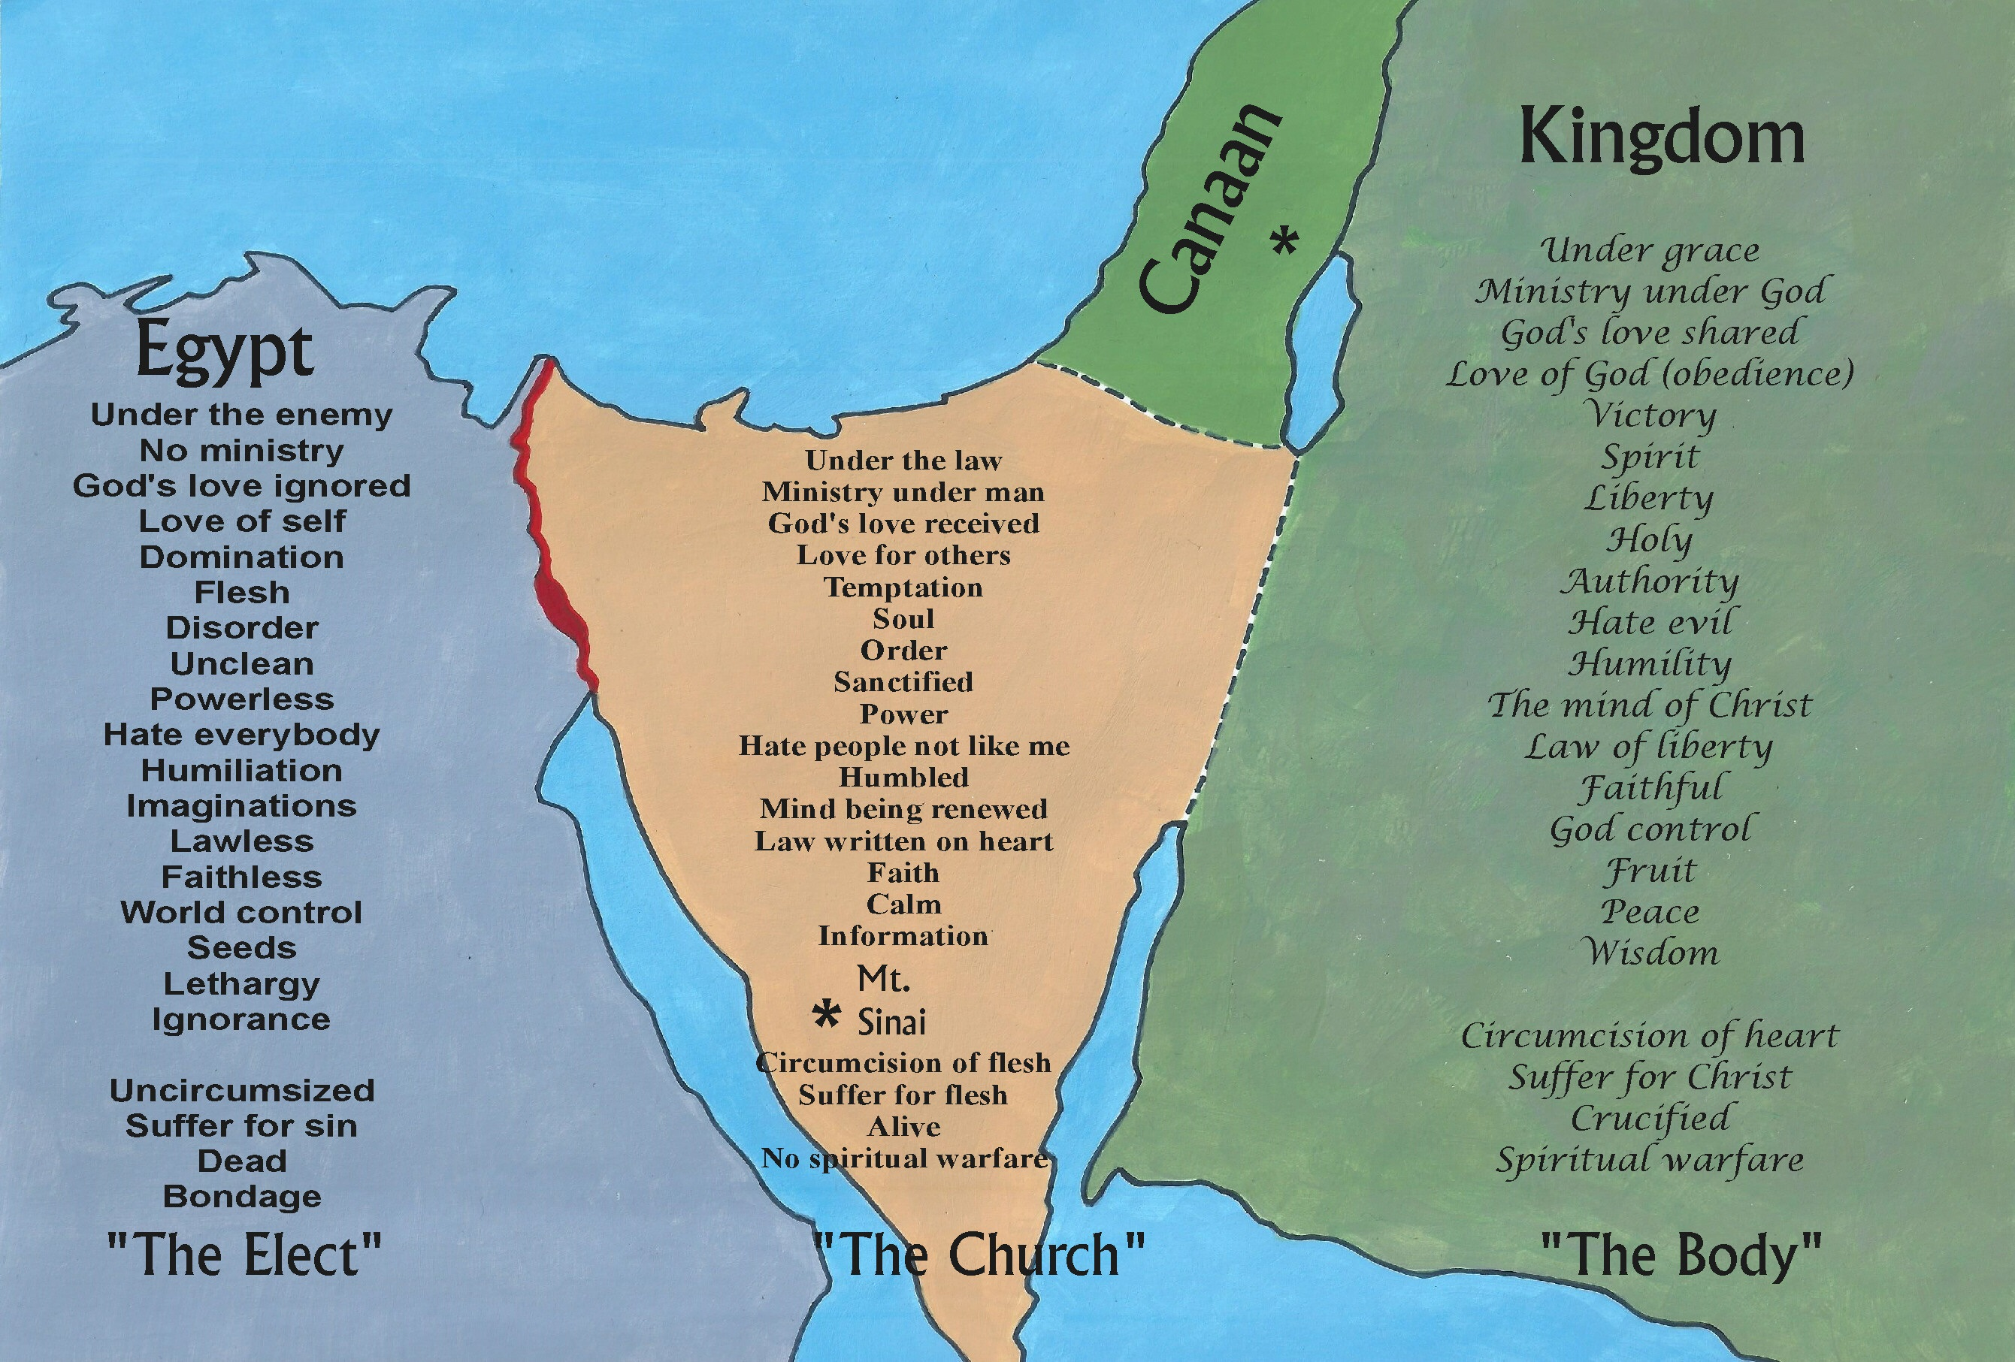
The Areas of Spiritual/ Natural Life
Where do we live

Slide 31
Enemies
Slander
Confusion
“accidents”
Fear, contempt for authority
Prophets no honor at home
Confuse flesh and spirit

Slide 32
Your friends
Angels
Word of God
Protective Garments
Music – snakes half deaf, distraction, enemy not omniscient; snake sniffs” out sin
Spirit of Truth
Gifts of the Spirit

Slide 33
Prophets to Consider - YouTube
Hank Kunneman
Robin Bullock
Kent Christmas
Timothy Dixon
Deb Williams
Wanda Alger
Elijah Steams
Elijah List
Dutch Sheets
No Comments
False titles
Profiteering by misusing others
GAB, PARLER are open somewhat
Notes:
No one man army – you need others praying those prophecies with you.

Slide 34
The End
This slide ends the course
What follows is interesting subsidiary material and some fun cartoons

Slide 35
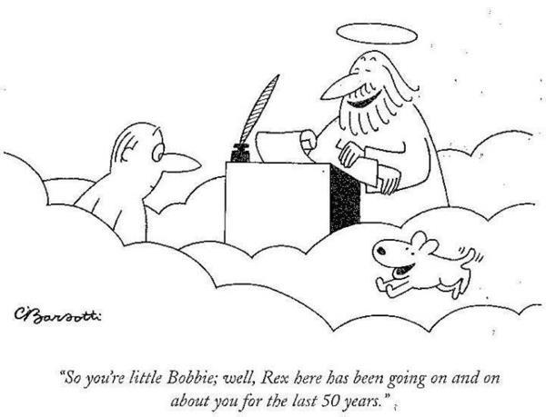
Heaven is for Real
Kat Kerr – heaven and where are your pets?
Notes:
Heaven is full of pets. How do we know. God loves us and wants us to be fulfilled and happy in heaven, with those we love, and that includes our beloved pets.

Slide 36
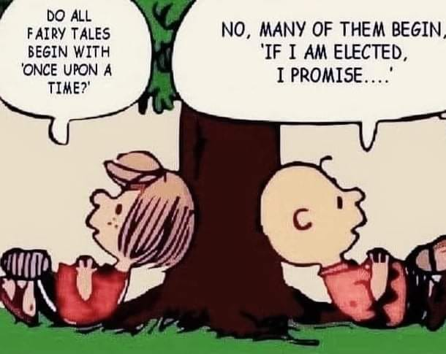
Praying for the Government
It’s always the guy at the top – or woman
Nero, Diocletian, Caligula
Notes:
No matter who is in charge, every generation has a satanic leader. Di not bother praying about the leader – pray for the demons controlling him and his administration.

Slide 37
Political Enemies
Winston Churchill said, "Socialism is a philosophy of failure, the creed of ignorance, and the gospel of envy, its inherent virtue is the equal sharing of misery."
Notes:
We do not pray about socialism we ray against the spirits of error, lies, greed, many fears, indoctrination, love of money, and any other the Spirit brings to mind.

Slide 38
Websites for Study
Matty’s Paradigm
A compete review of spiritual warfare, sample prayers, and background material – It’s long
  https://youtu.be/NVGeRPH6EiQ
  https://youtu.be/whTGFuScBME
  https://youtu.be/vLFMhLS89W8
  Black Robe Regiment

Slide 39
Demons
https://corneliascottcree.com/what-christians-should-know-about-demons/
HANDBOOK ON SPIRITUAL WARFARE
Spiritual Warfare.pptx

Slide 40
Satanism and Catholics strange fire
Praying to bless or promote evil
Dear Friend , Please read about our war against Satan and prayerfully consider becoming A Member of Saint Michael's Sword so we can continue and win this holy Crusade. See, we faced off with Satanists on July 10 to fight for the Holy Cross at Bladensburg, Maryland. In the middle of a three-way junction stands the Bladensburg Peace Cross, a World War I monument honoring fallen veterans. On the one side, dark-clad, howling Satanists, were the perfect image of vice and disorder. Amidst bizarre Satanic "music," one could see a man with goat horns, pride flags, while one mockingly parodied Christ by wearing a "crown of thorns" around his head. What united the pandemonium was a hatred for God, truth, and religion. And while the Satanic group pretended to be "atheist," everyone of them screamed over and over "Hail Satan!", and some even knelt on the ground, making the devil horns with their hands. Contrast that with the sons of light on the other side. Clean, prayerful Catholics offered an image of peaceful and energetic virtue. Braving the sun, the group prayed "Hail Marys" against the Satanist's cries of "Hail Satan," while red standards and bright signs attracted the attention of passing cars. The very young and very old enthusiastically filled the cross-section, and a beautiful statue of Our Lady of Fatima gave assurance of the devil's defeat. Every passing car was invited to take a stand: for good or evil, with the Cross or with the devil. Most showed their support for Christ's Cross with honks or thumbs-up. Thank God! The campaign was a success, showing public opinion's rejection of Satanism, and its love for Christ and the Cross. All of this was possible thanks to the generous prayers and support from the members of Saint Michael's Sword. If you have not joined, please consider giving spiritual and financial aid to our brave men as: A Member of Saint Michael's Sword Please see below some scenes of our recent action.
07/18/2021

Slide 41
On the one side, dark-clad, howling Satanists, were the perfect image of vice and disorder. Amidst bizarre Satanic "music," one could see a man with goat horns, pride flags, while one mockingly parodied Christ by wearing a "crown of thorns" around his head. What united the pandemonium was a hatred for God, truth, and religion. And while the Satanic group pretended to be "atheist," everyone of them screamed over and over "Hail Satan!", and some even knelt on the ground, making the devil horns with their hands.
Contrast that with the sons of light on the other side. Clean, prayerful Catholics offered an image of peaceful and energetic virtue. Braving the sun, the group prayed "Hail Marys" against the Satanist's cries of "Hail Satan," while red standards and bright signs attracted the attention of passing cars. The very young and very old enthusiastically filled the cross-section, and a beautiful statue of Our Lady of Fatima gave assurance of the devil's defeat.
Every passing car was invited to take a stand: for good or evil, with the Cross or with the devil. Most showed their support for Christ's Cross with honks or thumbs-up. Thank God!
The campaign was a success, showing public opinion's rejection of Satanism, and its love for Christ and the Cross.
All of this was possible thanks to the generous prayers and support from the members of Saint Michael's Sword.

Slide 42
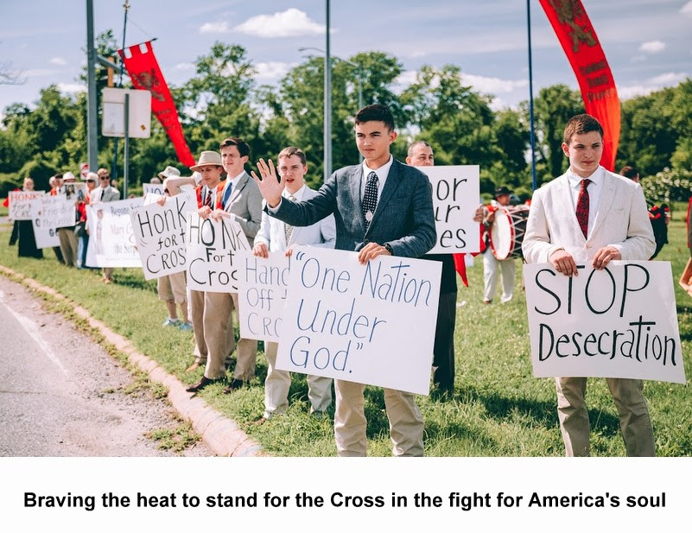

Slide 43
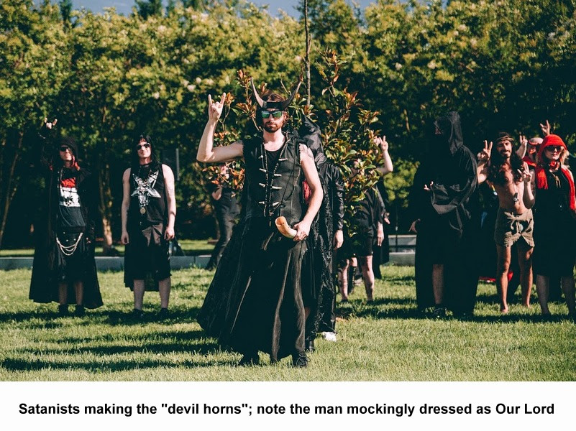

Slide 44
On the one side, dark-clad, howling Satanists, were the perfect image of vice and disorder. Amidst bizarre Satanic "music," one could see a man with goat horns, pride flags, while one mockingly parodied Christ by wearing a "crown of thorns" around his head. What united the pandemonium was a hatred for God, truth, and religion. And while the Satanic group pretended to be "atheist," everyone of them screamed over and over "Hail Satan!", and some even knelt on the ground, making the devil horns with their hands.
Contrast that with the sons of light on the other side. Clean, prayerful Catholics offered an image of peaceful and energetic virtue. Braving the sun, the group prayed "Hail Marys" against the Satanist's cries of "Hail Satan," while red standards and bright signs attracted the attention of passing cars. The very young and very old enthusiastically filled the cross-section, and a beautiful statue of Our Lady of Fatima gave assurance of the devil's defeat.
Every passing car was invited to take a stand: for good or evil, with the Cross or with the devil. Most showed their support for Christ's Cross with honks or thumbs-up. Thank God!
The campaign was a success, showing public opinion's rejection of Satanism, and its love for Christ and the Cross.
All of this was possible thanks to the generous prayers and support from the members of Saint Michael's Sword.

Slide 45
Repentance Prayer
Dear Lord Jesus, first I want to ask for Your help, strength and empowerment as I take on this challenge. Please give me clarity regarding the areas where I am struggling to succeed in You, but failing miserably. Lord, I confess my consternation at experiencing deadness and frustration rather than life and blessing. Help me identify the barriers facing me.
As a first step, I repent before You, and ask for forgiveness through the blood of Jesus for anything I have done in the past to cause You to be displeased with me or that may be the source of my frustrations.
Now I make this proclamation. In the name of Jesus, I stand against every area of deadness and barrenness in my life right now. I symbolically take up the new jar spoken of in the miracle that Elisha performed. I declare that this new jar filled with salt represents Your absolute healing for my failures, as well as a completely new beginning for my life. I throw that salt into the very spring of my entire life. Through the blood of Jesus, which brings complete healing and restoration, I make this declaration: No longer will death and failure come from the springs inside me, but instead…life and fruitfulness.
From this point forward, I declare that my life will be productive. By the grace of God, aspects that have been accursed will now be turned into areas of God’s blessing and favor for me and for all my family.
I further declare that 2012 will be a year of restoration for me. Dear Lord, You alone can restore the years that the locust has devoured. By faith, I receive Your abundant blessing and the restoration of that which the enemy has stolen from me and my loved ones in past years.
Thank You, Lord Jesus, for Your work of restoration in me. Thank You for Your life and productivity that will become the signature of my life from this point onward. Amen.
The late Derek Prince

Slide 46
Demons 101
Self-will
Witchcraft- stubbornness
Passive aggressive
Truth not in him – the-difference-between-being-born-again-and-saved
A born again person has Truth (Jesus) inside him; a saved person is a member of the family of God by adoption

Slide 47
For further study
Principalities of Jezebel, Athaliah and Delilah
  Dethroning
Pornography – Baal and
Religious Spirits – Keeps people under rules and regulations allowing them to pretend this is holy

